Slide 1
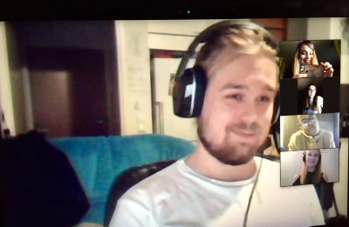
Conversifi Teacher Tuesday: Success factors in Virtual Exchange
Robert O'Dowd
University of León, Spain
@robodowd
robert.odowd@unileon.es
7 April 2020

Slide 2
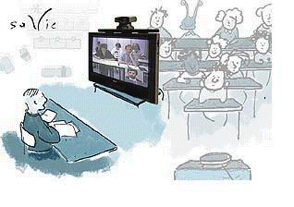
How many of you have already engaged your students in Virtual Exchange projects with students from other cultures?

Slide 3
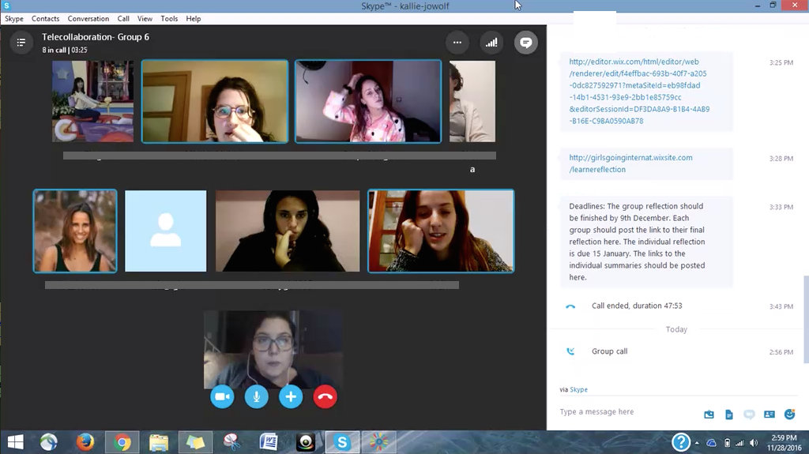
What is Virtual Exchange?
The engagement of groups of students in online intercultural interaction and collaboration…
…with students from other cultural contexts or geographical locations….
…as an integrated part of course work….
…and under the guidance of educators and/or expert facilitators.

Slide 4
Your thoughts:
What advantages does Virtual Exchange offer students of foreign languages?

Slide 5
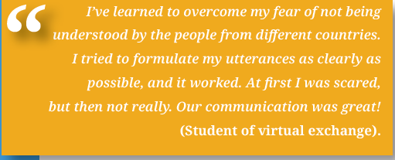
A qualitative content analysis of 345 Spanish students of EFL across 13 Virtual Exchanges: Main learning outcomes?
Increased confidence in using the L2 with peers
Nuanced ‘insider’ perspective on cultural information
“My partner’s family had to emigrate from Ireland and Germany. Her mother arrived to the USA during the Second World War but her father´s family had been in the USA since XIX century. …at the beginning it wasn´t easy, as she knows their family arrived to America by boat, suffering famine, storms and diseases.”
A more critical stance on the students’ home culture
“When I heard from [my partner] the treatment the immigrants received in Austria and I compared with immigration politics in Spain, I felt really disappointed. Spain does not seem to value the entrance of immigrants in its borders unless they have money to spend.”

Slide 6
But what do you think of this first message from a student in Germany to her new partner in Ireland?
Hello, how are you? I study English and history and I want to become a teacher. This term we do some cultural studies concerning Ireland and I very interested in it because I actually do not know much about it.
Now I would like to ask you some questions. Do you live in Northern or in Southern Ireland? How many people live in your town? Are you a Catholic or a Protestant? I have heard that regular churchgoing declines more and more in your country-is it true?
What are you doing in your free time? Do you often go to pubs? What do you think about Germans? Irish people have the reputation of being very indirect and polite in their speaking style. I have read that there was an enormous economic change in Ireland.
How have you or your parents experienced the social and economic change in the past 20 years?
That's all for now. I am looking forward to hearing from you!

Slide 7
Intercultural challenges in an Israeli-Spanish-Swedish Virtual Exchange:
Cultural differences in digital practices…
The teacher in Sweden reports to her partner teachers:
“One evening, a member of one of the other classes closed out an interaction with one of my students on whatsapp with a kiss emoji. Suddenly my student was stressed because she was faced with a difficult dilemma. Did she have to kiss her back? My student says she only sends kisses to close friends, but this was a group member and this whatsapp chat was more professional. However, if she didn't send a kiss back, what other emoji could she send?”

Slide 8
Critical success factor 1:
Students need guidance in their Virtual Exchanges –
Teachers must support them in analysing and engaging in their virtual interactions

Slide 9
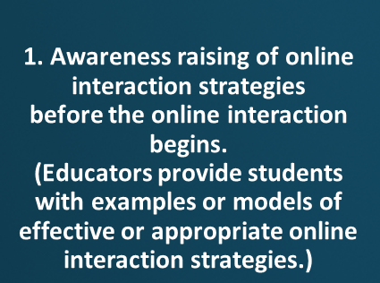
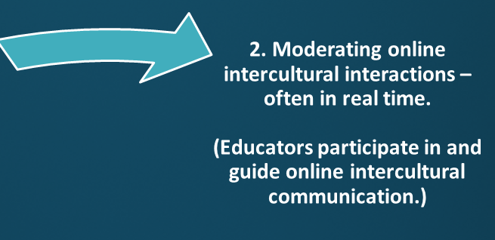
How can teachers mentor their students’ participation in Virtual Exchange? O’Dowd, R., Sauro, S., & Spector‐Cohen, E. (2019). The Role of Pedagogical Mentoring in Virtual Exchange. TESOL Quarterly, 54(1), 146–172.

Slide 10
What do you think of these common Virtual Exchange tasks?
Tell your partner about your favourite places to go out at night in your hometown.
Explore and compare with your partner the stereotypes you have of each other’s countries.
Post an image to the forum that exemplifies to your partners an aspect of their daily routine.

Slide 11
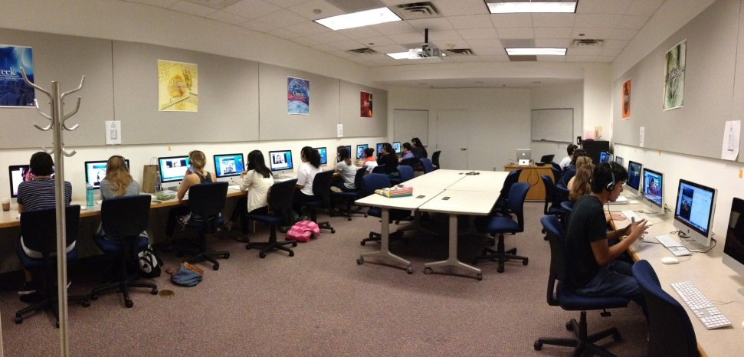
What do you notice about these students’ reactions when asked about cultural difference?
Student 1: “I will say that I liked the exchange very much and that American students looked like very nice people. I talked to them about my city and about theirs and it was nice to see that there are little differences but not as much as I thought.”
Student 2: “…It has been such an exciting experience because we have learned English while we have known a different culture. To my mind, we aren’t too different, both of us like sports, music and spending time with our friends.”
“I have realized that my partner and I aren’t so different, in fact, we have similar hobbies and ways to spend our free time. Like I have said, the main differences I see between her country and mine are the timetable and the weather.”

Slide 12
Critical success factor 2:
Students need tasks which force them to go beyond the mere exchange of information in their Virtual Exchanges

Slide 13
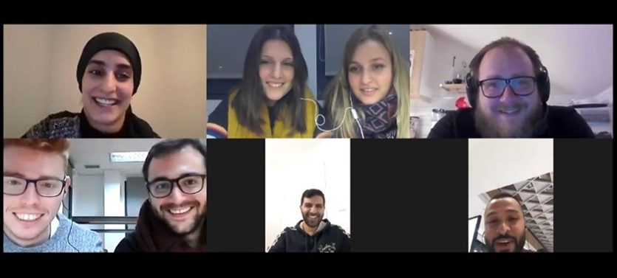
Learning outcomes from a transnational Virtual Exchange with Swedish-Spanish-Israeli classes of student-teachers who collaborated on making lesson plans together…
Collaboration skills and adaptability:
“[O]ther things that I have learnt were how to be patient working in groups, how to adapt myself to tricky situations and how to use new innovative teaching strategies.”
Intercultural skills:
“…Most of all, adaptability and flexibility. Working with people from different countries and with different timetables teaches you how to be patient and forces you to find a common (virtual) place and time in order for your collaborative project to succeed.”
Time-management and empathy:
“The fact of working with people from other countries prepares us for the future problems that we may have. That is to say, we learnt how to face problems of timing or agreement. I have also learnt that we have to understand and respect other people thoughts.”

Slide 14
Finally…critical success factor 3:
Students and teachers deserve academic recognition for their work in their Virtual Exchange

Slide 15
We asked 30+ teachers what they considered to be the key factors to the success or lack of success in the exchanges?
What do you think was the most common response?
Integrating the VE into your course programme and providing academic recognition (for both teachers and students) are key to success:
“….I’d suggest that the student engagement levels in telecollaborative exchanges have an explicit assessment rate within the course programmes they follow.”
“I would highly encourage integrating the exchange into the classes and suggest that they weave it into their course so it is a frequent topic of discussion.”
“We [teachers] …. Need a recognition of what we are doing. I believe teachers get motivated when what they do is valued. And this can be valued by giving them recognition for their work.”

Slide 16
To conclude…some take aways…
Virtual Exchange has great potential for language and intercultural learning …but it’s not a question of matching students and letting them get on with it.
Teachers should:
Provide not only opportunities for interaction but also opportunities to reflect on and learn from the interaction.
Consider tasks and exchange set-ups which do not make cultural comparison the primary focus - and which engage students in acts of collaboration with their partners.
Make sure that your VE forms part of your course programme and students receive recognition for their work
Notes:
16

Slide 17
Thank you for listening!
Contact: robert.odowd@unileon.es
Publications: http://unileon.academia.edu/RobertODowd
Twitter: @robodowd

